Slide 1
20XD14 -Problem Solving and C Programming
Arrays in C

Slide 2
Outline
Introduction to Arrays
Defining arrays – 1D arrays
Accessing array elements
Storing data vales into an array
Processing array elements

Slide 3
Introduction
Why do we need Arrays?
  The variables used so far have all had a common characteristic: each variable can only be used to store a single value at a time
  For example
    int num1;
    float price;
  num1 and price - can only store one value of the declared data type
The Problem
  Suppose we have 10 numbers to handle
  or 20
  or 100 (or even more)
  Where do we store the numbers ? Use 100 variables ??
  How to tackle this problem?

Slide 4
Introduction
Accept sales of a product for 12 months and find months of maximum and minimum sales
One way to accept sales of 12 months is declaration of 12 variables, accepting the data into individual variables and finding maximum and minimum using if-else selection statement
int m1, m2, m3, m4, m5, m6, m7, m8, m9, m10, m11, m12;
Another way of handling this problem is declaration of a single variable which can store 12 values of similar types
  Is it not simple to use a single variable rather using 12 variables to store 12 values?
  Ie., Use arrays

Slide 5
Definition
An array is a group of contiguous memory locations that all have the same type
Array is a data structure which can represent a collection of data items which have the same data type (float /int /char)
A collection of objects of the same type stored contiguously in memory under one name

Slide 6
Declaring Arrays
Like variables, the arrays that are used in a program must be declared before they are used
Syntax - One Dimensional (1D) array
  type array_name [ size ];
  type specifies the type of element that will be contained in the array (int, float, char, etc.)
  array_name - identifier
  size is an positive integer constant which indicates the maximum number of elements that can be stored inside the array
Note: int arr[-1];
  If size is negative – error : size of array 'arr' is negative
  int arr[ ]; - error : array size missing in arr

Slide 7
Arrays
#define A_SIZE 100
int main()
{ float temp[A_SIZE];
}
const int size=5;
int arr[size];
Examples
int x[10];
char line[80];
float points[150];
char name[35];
double temp[365];
    int b[ 100 ], x[ 27 ]; // Declaring multiple arrays of same type
If we are not sure of the exact size of the array, we can define an array of a large size
For example
int marks[50];
though in a particular run we may only be using, say, 10 elements

Slide 8
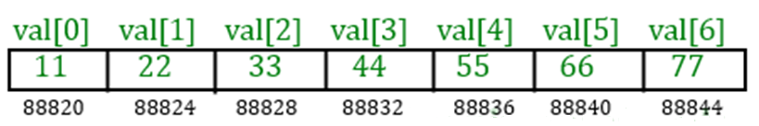
How an array is stored in memory?
Starting from a given memory location, the successive array elements are allocated space in consecutive memory locations
Example
int val[7];
b : starting address (base address) of the array in memory
k: number of bytes allocated per array element
a[i] - is allocated memory location at address b + i*k

Slide 9
How an array is stored in memory?
Starting address (base address) – 88820
k: number of bytes allocated per array element : k=4bytes
a[i] - is allocated memory location at address b + i*k
Memory location of val[3] = 88820 + 3 * 4
= 88820 + 12
= 88832

Slide 10
Accessing Array Elements
A particular element of the array can be accessed by specifying two things
  Name of the array
  Index (relative position) of the element in the array
In C, the index of an array starts from zero
Example
  An array is defined as int x[10];
  The first element of the array x can be accessed as x[0]
  The fourth element as x[3] and
  The tenth element as x[9], etc.

Slide 11
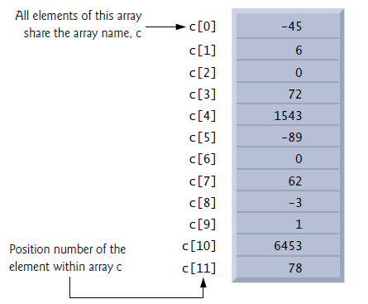
Accessing Array Elements
An indexed array name is an lvalue
It can be used on the left side of an assignment

Slide 12
A Warning
In C, while accessing array elements, array bounds are not checked
Example
int marks[5];
……..
marks[8] = 75;
The above assignment would not necessarily cause an error
Rather, it may result in unpredictable program results
[0] [1] [2] [3] [4]

Slide 13
Accessing Array Elements
printf(“%d”, val[0]); =>11
printf(“%d”, val[1]); =>22
printf(“%d”, 0[val]); =>11
printf(“%d”, 1[val]); =>22
printf(“%u”, val); =>88820
printf(“%u”, &val); =>88820
printf(“%u”, &val[0]); =>88820
printf(“%u”, &val[1]); =>88824

Slide 14

Example
Execution:
Enter two numbers:
23 78
Sum 101
Subtraction -55
Product 1794
#include<stdio.h>
int main()
{
int a[5];
printf("Enter two numbers:\n");
scanf("%d%d",&a[0], &a[1]);
a[2]=a[0]+a[1];
a[3]=a[0]-a[1];
a[4]=a[0]*a[1];
printf("Sum %d\nSubtraction %d\nProduct %d",a[2], a[3], a[4]);
return 0;
}

Slide 15
sizeof with arrays
sizeof() operator - used to find the size of a variable or type in bytes
Applying sizeof to an array name returns the number of bytes in the array
#include<stdio.h>
int main()
{
int a[5];
float x[7];
printf("Size of a %d",sizeof(a));
printf("\nSize of x %d",sizeof(x));
return 0;
}
#include<stdio.h>
int main()
{
int a[ ] = {1, 2, 3},len;
len=sizeof(a)/sizeof(a[0]);
printf("Length of array %d",len);
return 0;
}
Output:
Length of array 3
Output : Size of a 20
Size of x 28

Slide 16
Storing Data into an Array
(i) Initialization
General form
type array_name[size] = { list of values };
type array_name[ ] = { list of values };
Examples
int marks[5] = {72, 83, 65, 80, 76};
char name[3] = {‘P’, ‘S’, ‘G’};
char name1[ ] = “PSG TECH”;
float total[5] = {24.2, -12.5, 35.1};

Slide 17
Storing Data into an Array
Some special cases
If the number of values in the list is less than the number of elements, the remaining elements are automatically set to zero
float total[5] = {24.2, -12.5, 35.1};
total[0]=24.2, total[1]=-12.5, total[2]=35.1, total[3]=0, total[4]=0
char arr[3] = {‘A’, ‘B’};
arr[0]=A, arr[1]=B, arr[2]=\0 (null character)
int a[ ]={10,20,40,45,30,12}; /*size is optional */
char name[ ] = {‘P’, ‘G’, ‘G’ };
  The size may be omitted. In such cases the compiler automatically allocates enough space for all initialized elements
int a[6];
a={10,20,40,45,30,12 }; /* It results error */
int a[5] = {10, 20, 30, 40, 50, 60}; // warning : excess elements in
array initializer

Slide 18
Storing Data into an Array
(ii) Assignment
int arr[5];
a[0] = 10;
a[1] = 20;
a[3] = 30;
a[4] = 40;
char name[3];
name[0] = ‘P’;
name[1] = ‘S’;
name[2] = ‘G’;
(iii) Using Input functions
int arr[5], i;
1. scanf(“%d”, &arr[0]);
scanf(“%d”, &arr[1]);
scanf(“%d”, &arr[2]);
scanf(“%d”, &arr[3]);
scanf(“%d”, &arr[4]);
2. for(i=0; i<5; i++)
scanf(“%d”, &a[i]);

Slide 19
What does Array Name Signify?
Array name is the address of the start of the array
It always points to the beginning of the array - so the array name is like a constant pointer
Attempting to modify the value of an array name is a compilation error
Example
#include<stdio.h>
int main()
{
char XXX[10] = {‘P’, ‘S’, ‘G’, ‘ ‘, ‘T’, ‘E’, ‘C’, ‘H’};
++XXX; // XXX++, --XXX, XXX– also give the same error
printf(“%c”,XXX);
printf(“%c”,XXX[1]);
}
Error : lvalue required as increment operand

Slide 20
What does Array Name Signify?
The value of array name ‘XXX’ is the address of the 0th location i.e. a is equivalent to &XXX[0]
No value can be assigned to array name
int a[10] ;
........
a = .... // Illegal

Slide 21
Storing Data into an Array
Reading strings
char name[15];
  scanf(“%s”, name); //can read a string without blank space
  scanf(“%[^\n]”, name); // can read a string including blank space
  gets(name);
  for(i=0; i<15; i++)
  { scanf(“%c”, &name[i]);
  }
  for(i=0; i<15; i++)
  { name[i] = getchar();
  }

Slide 22
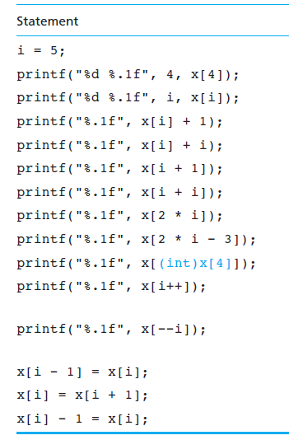
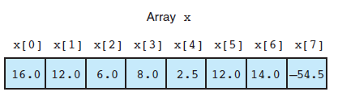
Array Subscripts

Slide 23
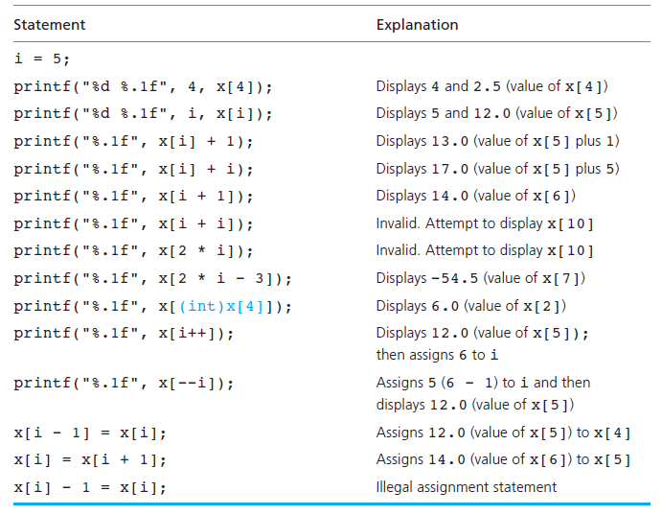
Array Subscripts

Slide 24
Reading and Printing Array Elements
Accept n elements into an array and print the elements in the accepted order
#include<stdio.h>
int main()
{
int n, i, arr[50];
printf("How many elements:");
scanf("%d",&n);
printf("Enter %d elements:\n",n);
for(i=0;i<n;i++) /* storing the data */
scanf("%d",&arr[i]);
printf("The given elements are:\n");
for(i=0;i<n;i++) /* printing data */
printf("%d",arr[i]);
return 0;
}
Execution :
How many elements: 6
Enter 6 elements:
12 56 87 67 65 45
The given elements are:
12 56 87 67 65 45

Slide 25
Reading and Printing Array Elements
for(i=0; i<5; i++) /* storing the data */
scanf("%d",&arr[i]);
for(i=0; i<5; i++) /* printing data */
printf("%d",arr[i]);
i=0 scanf("%d",&arr[0]);
i=1 scanf("%d",&arr[1]);
i=2 scanf("%d",&arr[2]);
i=3 scanf("%d",&arr[3]);
i=4 scanf("%d",&arr[4]);
i=0 printf("%d", arr[0]);
i=1 printf("%d", arr[1]);
i=2 printf("%d", arr[2]);
i=3 printf("%d", arr[3]);
i=4 printf("%d", arr[4]);

Slide 26
Reading and Printing Array Elements
Accept n elements into an array and print them in reverse order
Execution
How many elements? 5
Enter 5 elements:
12 67 54 34 98
Elements in reverse order:
98 34 54 67 12
#include<stdio.h>
int main()
{
int n, i, arr[50];
printf("How many elements?");
scanf("%d",&n);
printf("Enter %d elements:\n",n);
for(i=0;i<n;i++)
scanf("%d",&arr[i]);
printf("Elements in reverse order:\n");
for(i=n-1;i>=0;i- -)
printf("%d",arr[i]);
return 0;
}
n=5
i=4 printf("%d", arr[4]); 98
i=3 printf("%d", arr[3]); 34
i=2 printf("%d", arr[2]); 54
i=1 printf("%d", arr[1]); 67
i=0 printf("%d", arr[0]); 12
i=-1 -1>=0 (false)
12 | 67 | 54 | 34 | 98
[0] [1] [2] [3] [4]

Slide 27
Arrays
You cannot
  use = to assign one array variable to another
  a = b; /* a and b are arrays */
  use == to directly compare array variables
  if (a = = b) ………..
  directly scanf or printf arrays
  printf (“……”, a);
By copying individual elements
for (j=0; j<25; j++)
  a[j] = b[j]; /* a and b are arrays */

Slide 28
Processing Array Elements
Accept n elements into an array and print the sum of those numbers
#include<stdio.h>
int main()
{
int n, i, a[50],sum;
printf("How many elements?");
scanf("%d",&n);
printf("Enter %d elements:\n",n);
for(i=0;i<n;i++)
scanf("%d",&a[i]);
for(sum=0,i=0;i<n;i++)
sum=sum+a[i];
printf("Sum of all the elements %d",sum);
return 0;
}
Execution:
How many elements? 6
Enter 6 elements:
12 67 54 34 98 10
Sum of all the elements 275

Slide 29
Processing Array Elements
for(sum=0,i=0;i<5;i++)
sum=sum+a[i];
10 | 20 | 30 | 40 | 50
[0] [1] [2] [3] [4]
sum =0
i=0
I iteration : 0 < 5 (True)
sum = sum + a[0]
= 0 + 10
sum =10
i=1
II iteration : 1<5 (True)
sum = sum + a[1]
= 10 + 20
sum =30
i=2
III iteration : 2 < 5 (True)
sum = sum + a[2]
= 30 + 30
sum =60
i=3
IV iteration : 3<5 (True)
sum = sum + a[3]
= 60 + 40
sum =100
i=4
V iteration : 4<5 (True)
sum = sum + a[4]
= 100 + 50
sum =150
i=5
VI iteration : 5<5 (False)

Slide 30
Processing Array Elements
Accept n elements into an array and print the maximum and minimum elements
#include<stdio.h>
int main()
{
int n,i,min,max,a[50];
printf("How many elements?");
scanf("%d",&n);
printf("Enter %d elements:\n",n);
for(i=0;i<n;i++)
scanf("%d",&a[i]);
for(min=max=a[0], i=1; i<n; i++)
{
if(a[i]<min)
min=a[i];
if(a[i]>max)
max=a[i];
}
printf("Minimum element %d",min);
printf("\nMaximum element %d",max);
return 0;
}

Slide 31
Processing Array Elements
for(min=max=a[0], i=1; i<n; i++)
{ if(a[i]<min)
min=a[i];
if(a[i]>max)
max=a[i]; }
10 | 4 | 5 | 8 | 1
[0] [1] [2] [3] [4]
III iteration
i=3, 3<5(True)
a[3] < min => 8<4 (False)
a[3] > max => 8>10(Flase)
IV iteration
i=4, 4<5 (True)
a[4] < min => 1<4 (True)
min = 1
a[4] > max => 1>10(Flase)
V iteration
i=5, 5<5 (False)
min = 1
Max = 10
min = max = a[0]
min = 10
max =10
I iteration
i=1, i<5 (True)
a[1] < min => 4<10 (True)
min =4
a[1] > max => 4>10(False)
II iteration
i=2, 2<5 (True)
a[2] < min => 5<4 (False)
a[2] > max => 5>10(Flase)

Slide 32
Processing Array Elements
Linear Search
#include<stdio.h>
int main()
{
int n, i, x, s, a[50];
printf("How many elements?");
scanf("%d",&n);
printf("Enter %d elements:\n",n);
for(i=0;i<n;i++)
scanf("%d",&a[i]);
printf("Find what?");
scanf("%d",&s);
x=0;
for( i=0; i<n; i++) {
if( a[i] == s )
{ x=1;
break;
}
}
if(x)
printf(“present");
else
printf("Not present");
return 0;
}

Slide 33
Processing Array Elements
Sorting - Bubble Sort
for(j=n-2; j>=0; j- -)
{ for(i=0;i<=j;i++)
if(a[i+1]<a[i])
{
temp=a[i];
a[i]=a[i+1];
a[i+1]=temp;
}
}
/* printing the array elements */
printf("Elements in ascending order:\n");
for(i=0;i<n;i++)
printf("%5d",a[i]);
return 0;
}
#include<stdio.h>
int main()
{
int a[50],n,i,j,temp;
/* accepting elements into array*/
printf("How many elements?");
scanf("%d",&n);
printf("Enter %d elements:\n",n);
for(i=0;i<n;i++)
scanf("%d",&a[i]);
/* sorting the elements */

Slide 34
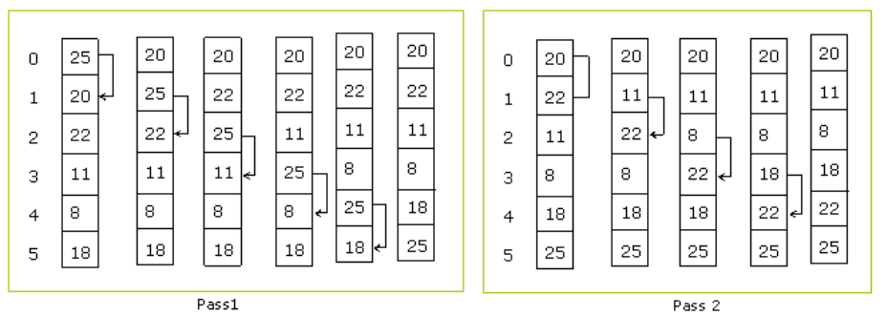
Processing Array Elements

Slide 35
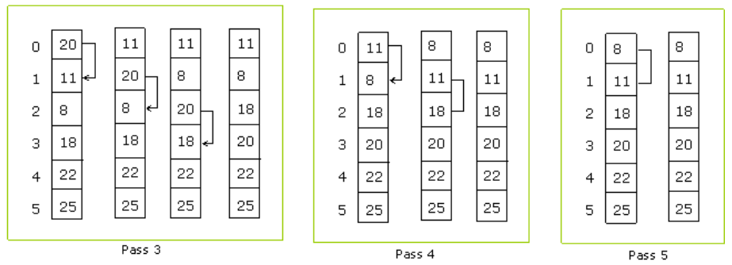
Processing Array Elements

Slide 36
Homework
Accept “n” elements into an array and print the sum of even and odd elements
Accept n elements into an array, copy the elements onto another array and print the resultant array
Accept “n” elements into an array and modify the element at a required position and print the resultant array
Accept two arrays of n elements and print whether they are equal or not
Accept “n” elements into an array and print the number of positive numbers, negative numbers, zeros, even numbers and odd numbers
Accept “n” elements into an array, insert an element at a required position and print the resultant array
Accept “n” elements into an array, delete an element at a required position and print the resultant array

